Slide 1
Developing Informatics Tools in Support of Meaningful Use Electronic Physician Reporting to State Cancer Registries
Wendy Blumenthal, MPH
Health Scientist
CDC Cancer Surveillance Branch
2014 Public Health Informatics Conference
April 30, 2014
National Center for Chronic Disease Prevention and Health Promotion
Division of Cancer Prevention and Control

Slide 2
Cancer Surveillance Overview
1992 Cancer Registry Amendment Act, Public Law 102-515, authorized CDC to establish National Program of Cancer Registries (NPCR)
  Worked with states to develop model legislation and regulations
Cancer is a nationally reportable disease
Collect data on all cancers diagnosed
Highly standardized data collection system
  Coordinated across multiple agencies (CDC, National Cancer Institute, and American College of Surgeons Commission on Cancer ) through North American Association of Central Cancer Registries (NAACCR)

Slide 3
Cancer Surveillance
Regional, state and territorial Central Cancer Registries (CCRs) are data systems that collect, manage, and analyze data about cancer cases and cancer deaths
Cancer surveillance is a complex system that captures longitudinal data from multiple data sources using a variety of methods
In addition to recording the occurrence of each reportable cancer (or tumor), the reporters provide information to CCRs on the tumor diagnosis, stage and treatment as well as vital status
Legislation requiring cancer reporting by healthcare providers to state cancer registries exists in all states with some variation in specific requirements

Slide 4
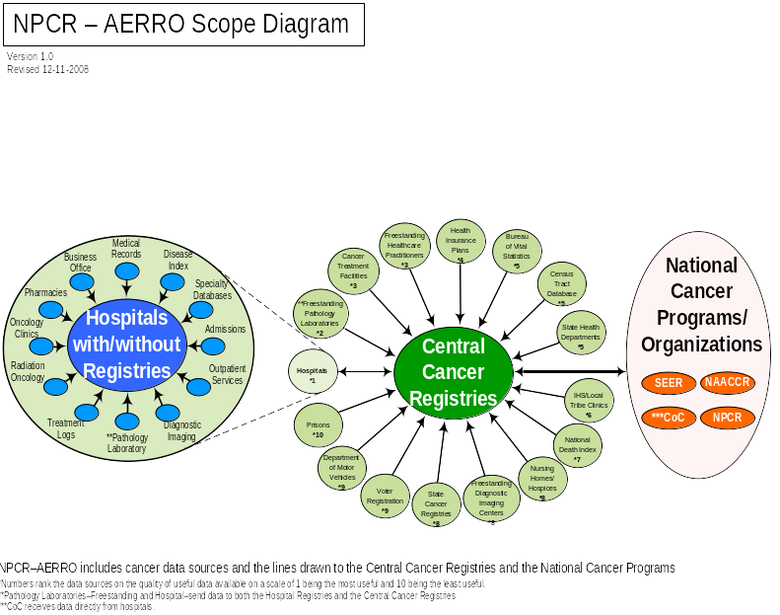
Notes:
Traditional data collection for state cancer registries has been primarily from hospitals and anatomic pathology laboratories. As medical advances have occurred, diagnosis and treatment of certain cancers has moved from acute care settings to physician offices and other outpatient settings. Many state cancer registries have difficulties getting physicians to report cancer cases, resulting in reporting delays and under-reporting. Surveillance of incidence rates and cancer research are adversely affected by this incomplete data collection. To improve reporting, the Centers for Disease Control and Prevention (CDC) Cancer Surveillance Branch, the North American Association of Central Cancer Registries (NAACCR), and the cancer registry community established activities to implement electronic reporting from clinic and physician office Electronic Health Records (EHRs) to state cancer registries using public health informatics strategies and national standards for data exchange, data transmission, and data processing.

Slide 5
CMS and ONC Meaningful Use Final Rules for Cancer Reporting
CMS Stage 2 Menu Objective for Eligible Professionals:
  Capability to identify and report cancer cases to a State cancer registry, except where prohibited, and in accordance with applicable law and practice
ONC 2014 Edition EHR Certification Criteria:
  Optional---ambulatory setting only—transmission to cancer registries. EHR technology must be able to electronically create cancer case information for electronic transmission in accordance with the Implementation Guide for Ambulatory Healthcare Provider Reporting to Central Cancer Registries, HL7 Clinical Document Architecture (CDA)
Implementation began January 2014

Slide 6
Physician Cancer Reporting Requirements (1)
Tool needs to be available for use by EHR vendors and providers to test cancer CDA reports as well as by state cancer registries to analyze reports received
Vendors, providers and registries need to perform robust structural and content validation of the physician reports in the HL7 Clinical Document Architecture (CDA) format required for MU
Need to expand on the existing Schematron tool developed by NIST for ONC’s EHR certification process

Slide 7
Physician Reporting Needs (2)
HL7 CDA is brand new to cancer registries
  Need tool to “read” and parse CDA documents
Data elements in the EHRs and therefore in the CDA cancer report often do not map exactly to cancer registry data elements
  Complex mapping rules and translations were developed by the cancer registry community
  Cancer registries receive reports from multiple sources for the same patient and tumor, and now will also receive multiple reports from the same provider for the same patient and tumor
  Consolidation functionality needed to merge multiple reports from the same provider for the same patient and tumor

Slide 8
Physician Reporting Needs (3)
Cancer registries have different needs for imports into central cancer registry database
  Some registries want to export all cancer abstracts immediately for import into central database
  Some want to wait until patient’s treatment is completed and export a single consolidated abstract for import into central database
  Some only want to export abstracts for cancer types that are likely un- or under-reported from hospitals, such as melanoma, prostate, bladder and leukemia.
  Highly configurable export features needed to address these diverse needs

Slide 9
New Tool Development: eMaRC Plus Physician Reporting Module
Electronic Mapping, Reporting, and Coding (eMaRC) Plus
Imports and parses physician cancer HL7 Clinical Document Architecture (CDA) reports
The physician reporting module was developed as an enhancement to eMaRC Plus.
  eMaRC Plus also includes a module to process HL7 version 2.5 electronic pathology reports.
Maps and translates CDA data elements and values from concepts and vocabularies used by EHRs to the NAACCR Standards for Cancer Registries, Volume II, Data Standards and Data Dictionary used by state cancer registries
Consolidates information from multiple cancer reports into a single cancer abstract, and enables abstracts to be exported in the NAACCR record layout
Part of CDC’s Registry Plus suite of free-of-charge software

Slide 10
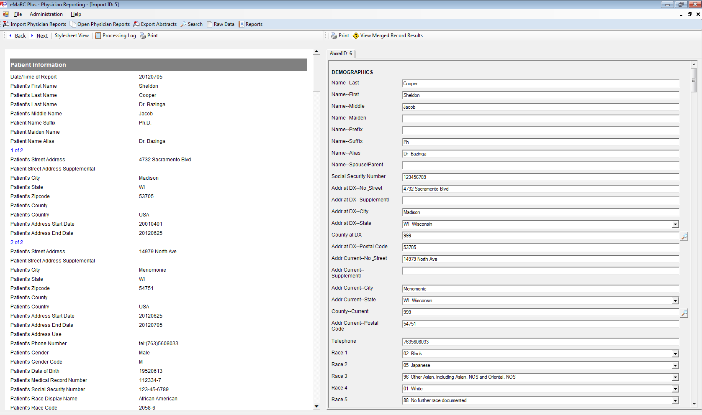
eMaRC Plus—Mapping Rules Example

Slide 11
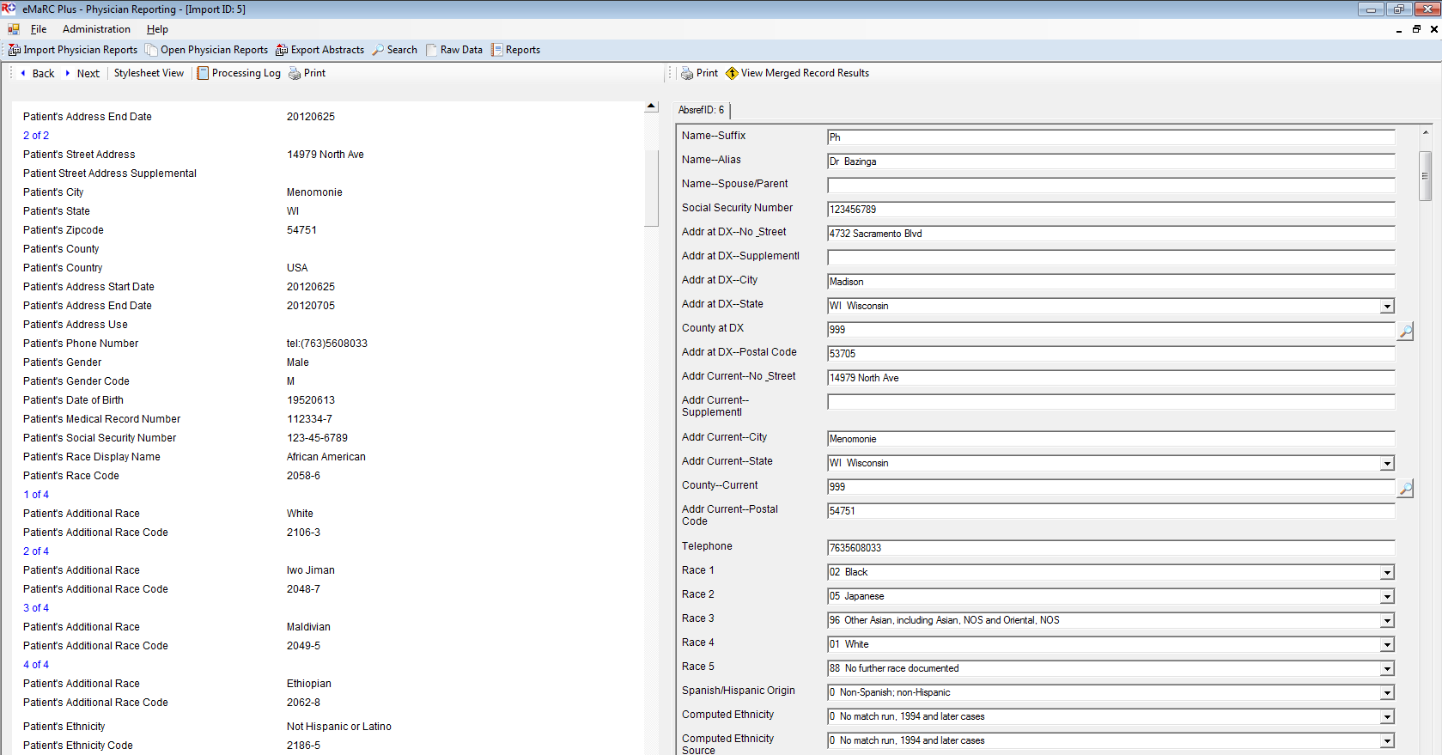
eMaRC Plus—Mapping &Translation Example

Slide 12
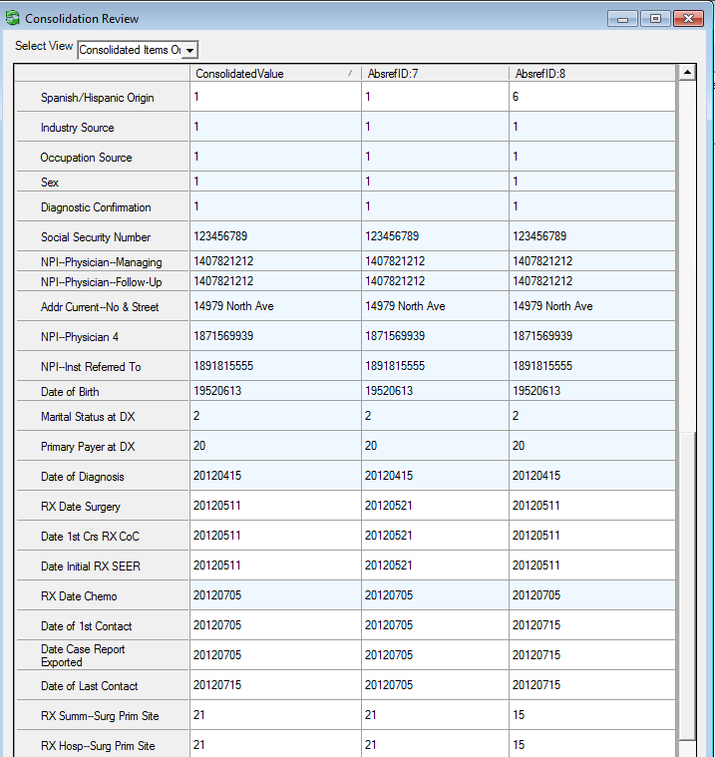
eMaRC Plus—Consolidation Example

Slide 13
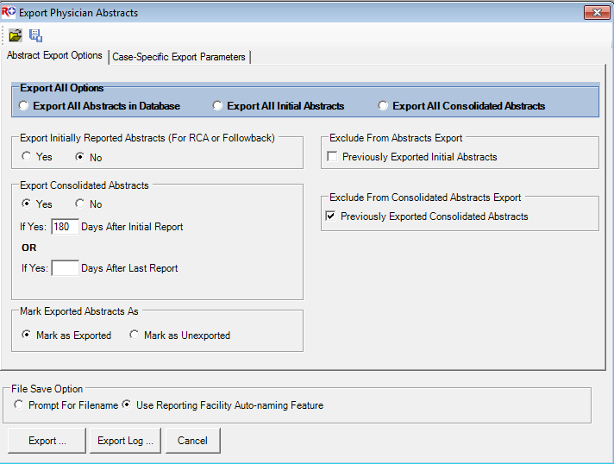
eMaRC Plus—Export Options

Slide 14
New Tool Development:
CDA Validation Plus
Developed by CDC Cancer Surveillance Branch
First release 11/22/2013; Version 2.0 released 4/15/2014
Assists EHR vendors and state cancer registries to test and validate HL7 CDA cancer reports from EPs for MU Stage 2 cancer reporting
Performs structural and content validation based on the specifications in the Implementation Guide for Ambulatory Healthcare Provider Reporting to Central Cancer Registries, August 2012, Release 1.0

Slide 15
CDA Validation Plus
Does NOT replace the testing and validation process that MUST be completed by EHR vendors with the Office of the National Coordinator - Authorized Testing and EHR Certification Bodies (ONC-ATCBs) to receive the required MU certifications
It is to be used to augment the validation process and improve interoperability for cancer reporting
Will be continually refined and enhanced based on functionality needs of end users
See Training Manual for details on validation rules
  Page 9 describes types of validation rules
  Pages 10-12 provide examples
  Appendix B provides list of all rule types applied to data elements

Slide 16
CDA Validation Plus
Content validation includes checks for required elements and valid vocabulary values
Generates user-friendly reports that can be printed and saved
  Reports can be saved to an extensive number of file formats
Stand-alone desktop application
Validation can be performed manually on a single document or a batch of documents
Validation of a batch of documents can be automated through a command line interface

Slide 17
CDA Validation Plus:
Validation Rule Types
Critical missing required fields
  Subset of required data elements that are considered critical to cancer registries
Missing required fields
  Usually required by cancer registries but may not all be present in every CDA message and can be null in certain circumstances
Invalid or unexpected null flavor
Invalid Code System OID
Invalid values
Data element formatting, including:
  Social security number, telephone number, National Provider Identifier (NPI), and CPT and HCPCS codes
Cancer Reportability

Slide 18
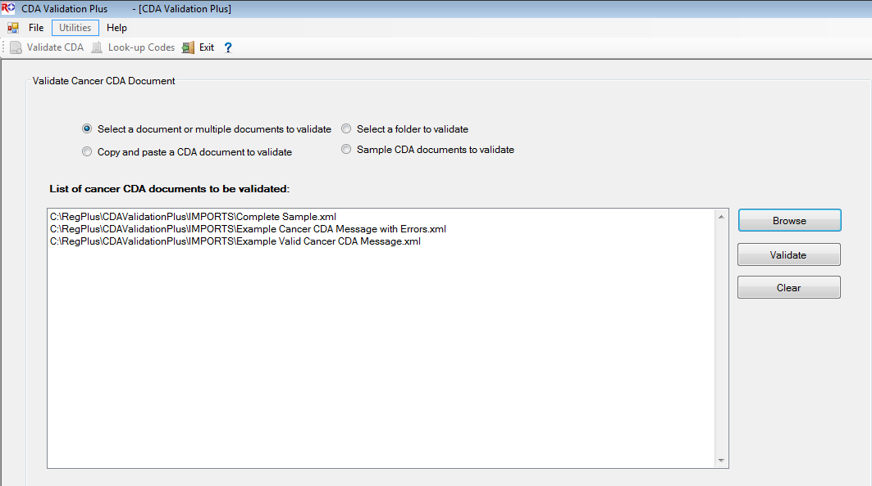
CDA Validation Plus: Validation Window

Slide 19
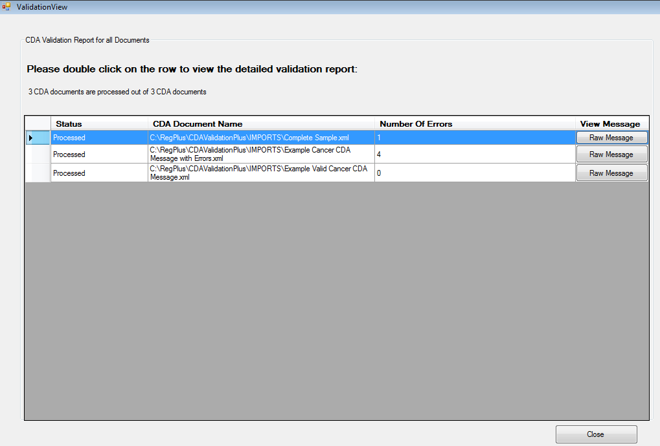
CDA Validation Plus: Report Summary

Slide 20
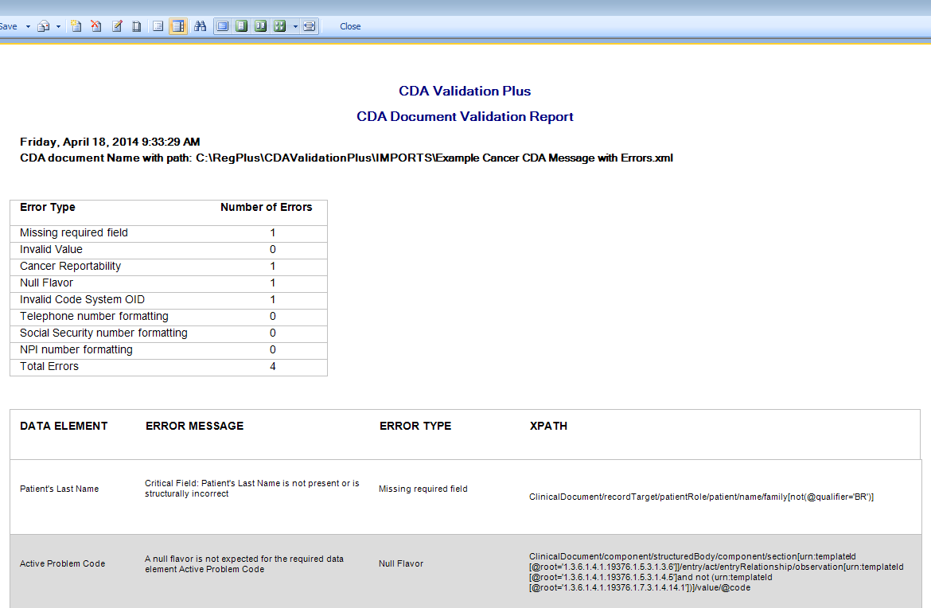
CDA Validation Plus: Detailed Report

Slide 21
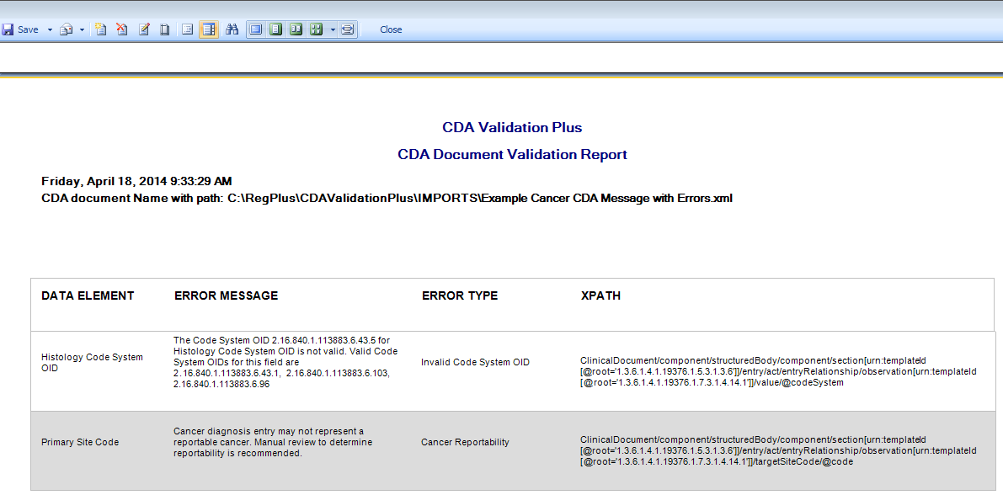
CDA Validation Plus: Detailed Report

Slide 22
Patient Centered Outcomes Research (PCOR)
PCOR funding received from HHS to expand on Comparative Research Effectiveness project
Extend follow-up of breast, colon, rectum cancer cases through 2014
Expand EHR reporting to cancer registries for comparative effectiveness research by addressing requirements to implement Meaningful Use cancer reporting, including
  Testing and enhancement of software tools
  Improved methodology for management and processing of electronic data on a real time basis
  Technical assistance, training, and guidance to cancer registries

Slide 23
Resources
If you would like to download either eMaRC Plus or CDA Validation Plus, please contact Lindsay Ryan (viu3@cdc.gov) for instructions
For more information about MU Cancer Reporting, or to download the Implementation Guide and guidance documents please see the NPCR MU Web Site: http://www.cdc.gov/cancer/npcr/meaningful_use.htm
For questions about MU reporting, please contact MeaningfulUse@cdc.gov

Slide 24
Thank you!
Wendy Blumenthal
wblumenthal@cdc.gov
770-488-1131
National Center for Chronic Disease Prevention and Health Promotion
Division of Cancer Prevention and Control

